Slide 1
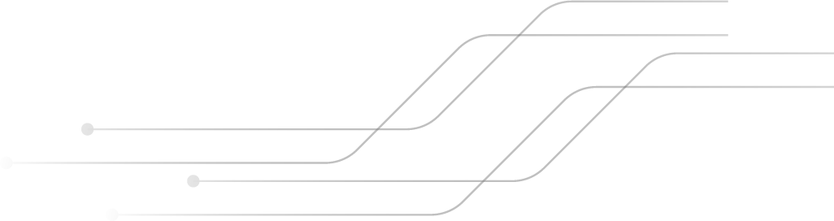

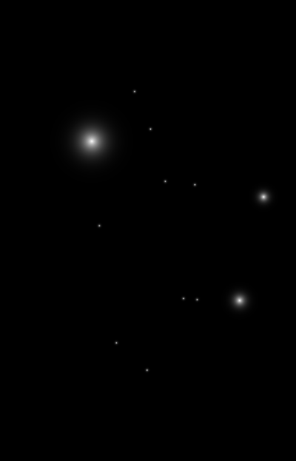

ModSecurity-WAF with Nginx & OWASP-CRS
By : Mohammad Nemer

Slide 2

TABLE OF CONTENTS
01
02
03
What’s WAF
Why ModSecurity
Architecture
04
05
06
Outcome
Conclusion
Demo
1

Slide 3
What’s WAF ?
01

Slide 4


WAF
Defense layer in front of a web application
Filter and monitor http traffic
Deal with attacks like SQLi, XSS, and cross site forgery
A layer 7 protocol
Reverse proxy between users and server
Operate through set of defined rules and policies
3

Slide 5
Types of WAF
Hardware-based
Host-based
Cloud based
An implemented Hardware device that works efficiently expensive for deploying and maintaining
Integrated in application’s software, less expensive and more customizable, complex to implement and maintain
Ease of implementation, integrate with services, unpredictable costs, latency, vendor lock in
4

Slide 6
Why ModSecurity ?
02

Slide 7

ModSecurity
Developed by OWASP, Trustwave SpiderLabs, first come to life at 2002 and has a 2024 stable release
Customizable set of rules
Open –source
Wide compatibility : Nginx, Apache, and IIS.
Flexible rule engine
OWASP CRS and Anomaly scoring
Real-Time monitoring & logging
6

Slide 8
Architecture
03

Slide 9
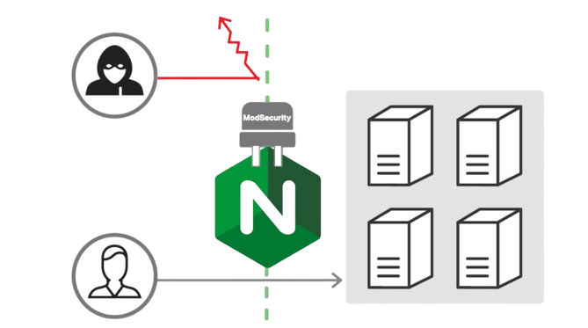
ModSecurity with Nginx
Modsec module
With rule engine configured with OWASP CRS
connector
Bridge between modsec & nginx
Nginx
web server and reverse proxy server. Traffic manager and a load balancer
8

Slide 10
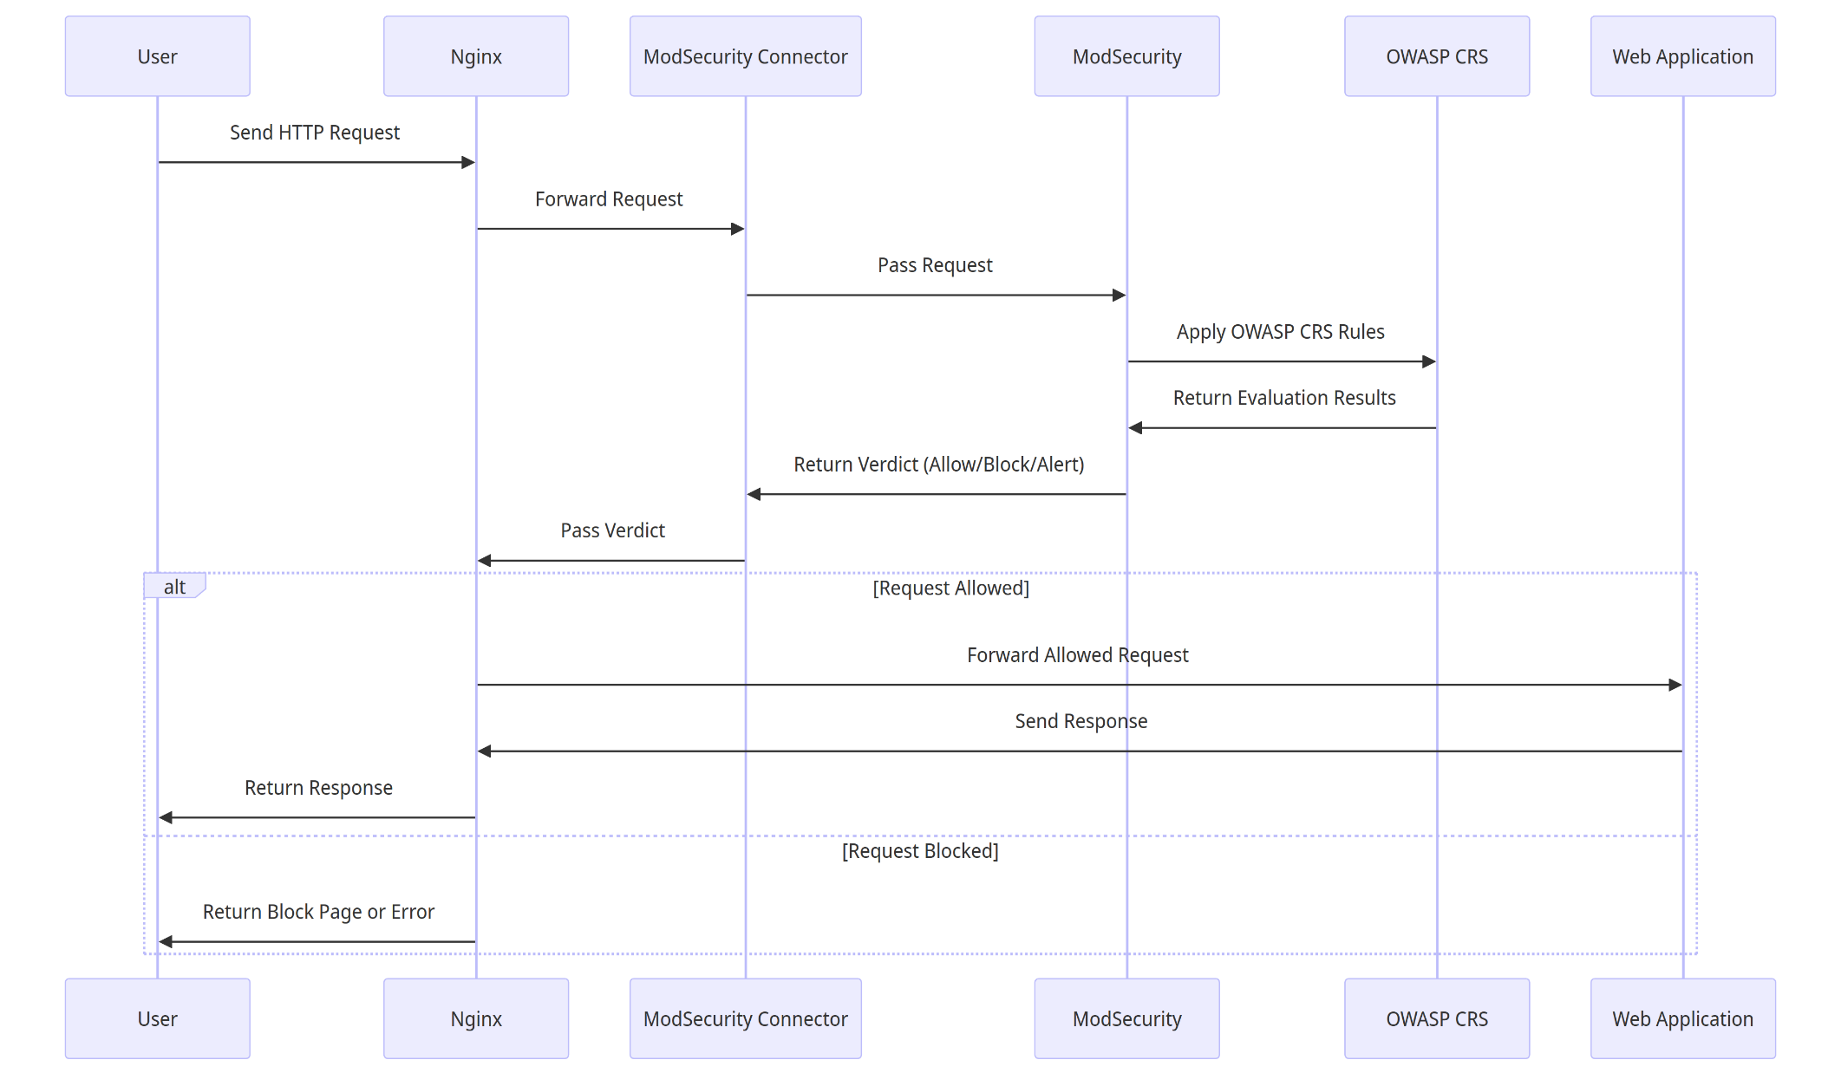
9

Slide 11
Outcome
04

Slide 12
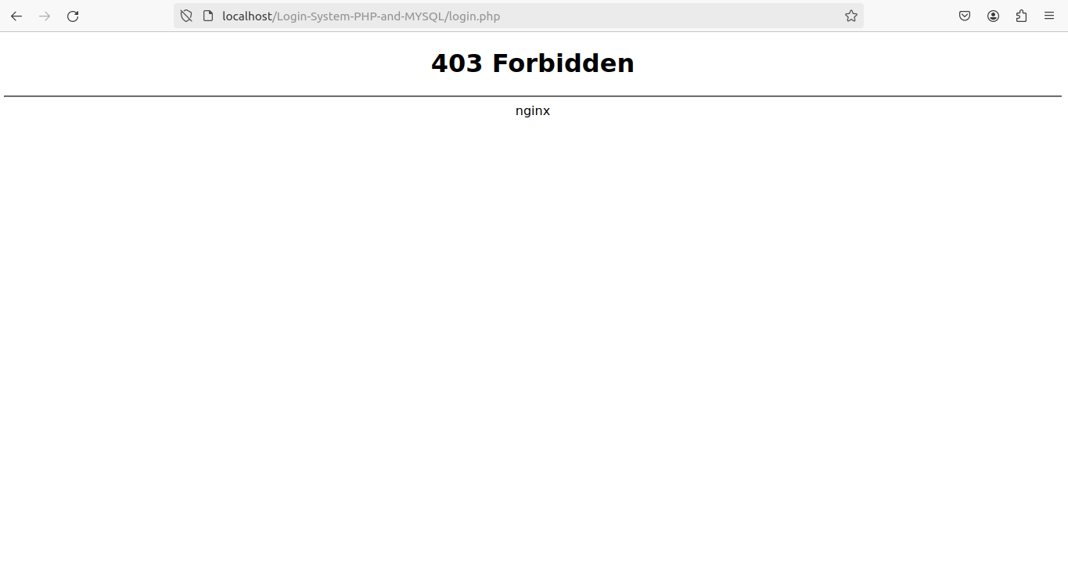
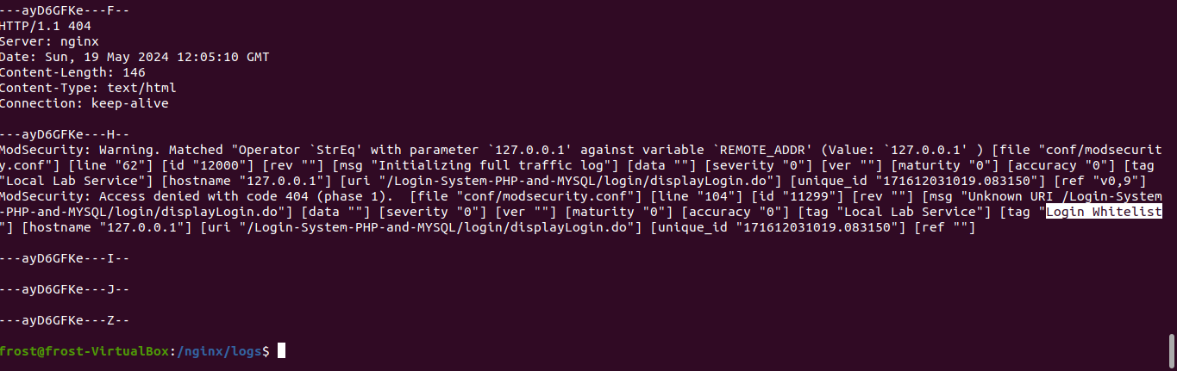
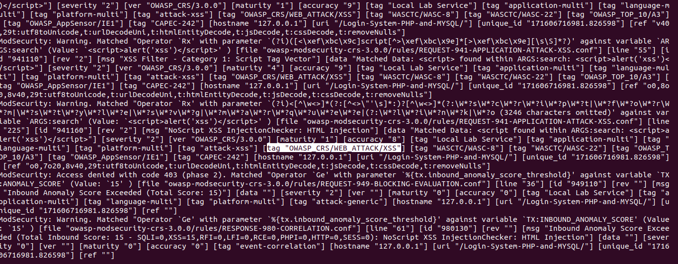
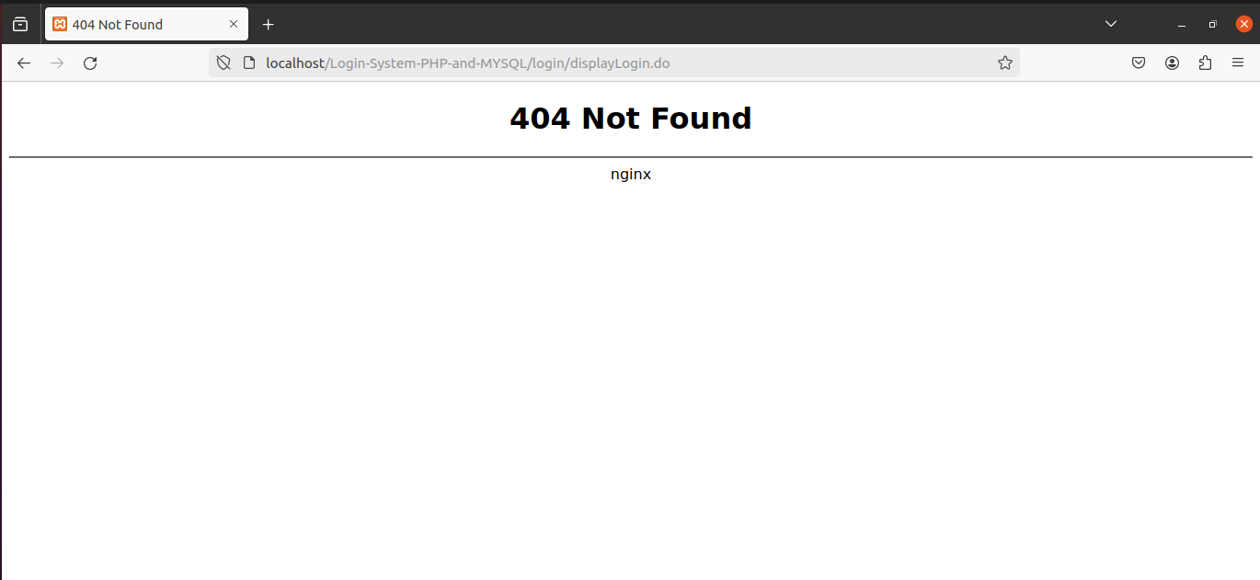
Response & Logs
11

Slide 13
Conclusion
05
12

Slide 14
WAF is critical because
protecting web applications from common threats
Compliance with industry standards and regulations
Enhances security posture and reduces risk
13

Slide 15
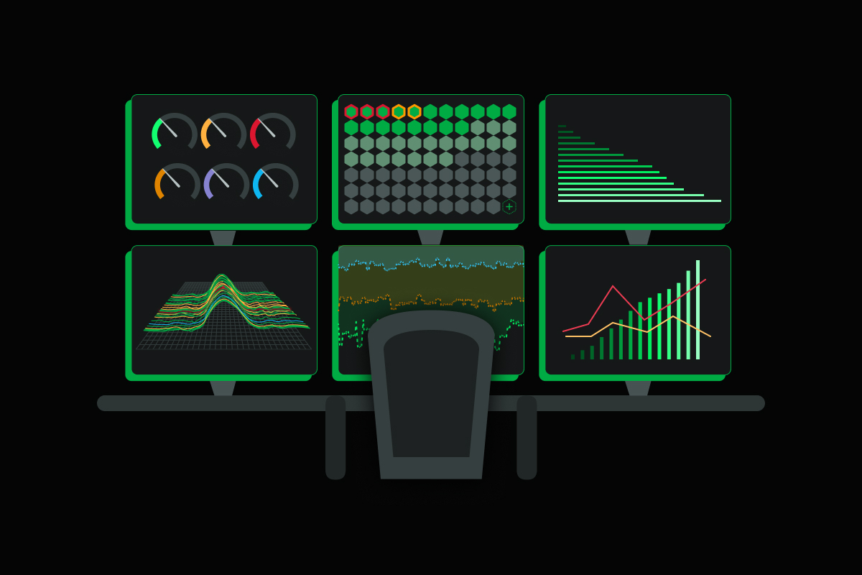
Further steps
Monitoring and alerting
Data analysis and visualization
Incident Response plan
14

Slide 16
Demo time !
05

Slide 17
THANKS!

